Slide 1




SMART INDIA HACKATHON 2022

Slide 2

AICTE
ALL INDIA COUNCIL FOR TECHNICAL
EDUCATION
PS Code – DR703
Problem Statement Title - Bulk email & SMS service Theme Name – Smart Education
TEAM NAME – DAZZLING DEVELOPERS
DR. AKHILESH DAS GUPTA INSTITUTE OF TECHNOLOGY
AND MANAGEMENT, DELHI
INSTITUTE CODE(AISHE) – [C-32842]

Slide 3
TEAM INTRODUCTION – DAZZLING DEVELOPERS
Team Leader – Pratyush Bhatnagar | Branch – CSE | Year – III
Team Member 1 – Rishabh Kumar | Branch – IT | Year – III
Team Member 2 – Hemant Singh | Branch – IT | Year – III
Team Member 3 – Akshat Aggarwal | Branch – IT | Year - III
Team Member 4 – Anshul Vats | Branch – IT | Year - III
Team Member 5 – Babita | Branch – CSE | Year – III

Slide 4
Background: Information sharing is a major factor for development in the country. It is a time taking process to share information to all the citizens of the country through media and newspaper.
A bulk SMS or email service which can convey information to larger audience in short interval of time is a requirement.
Objective: We need a mobile/web app that will allow sending Bulk email & SMS (around 1 crore) user in one go through SMTP or other technology and it will be compatible for that.
PROBLEM STATEMENT

Slide 5
OUR APPROACH & TECH STACK USED
Since the Problem statement emphasizes on creating a solution for communicating and sharing Information to vast audience at a minimal duration of time via SMS/email, our software fulfills the requirements of communication alongside with the additional features as well.
The Recipients list can be selected manually or can be automatically imported through .doc files or. xls sheets. The Website will be using SMTP (Simple Mail Transfer Protocol) API for sending information over email/SMS. It will show status of success or failure with time.
Server Backend: Node.js, Express.js
Database: my-SQL
Information Sharing: Email sending APIs (SMTP Technology)
Website Frontend: HTML, CSS, JavaScript

Slide 6
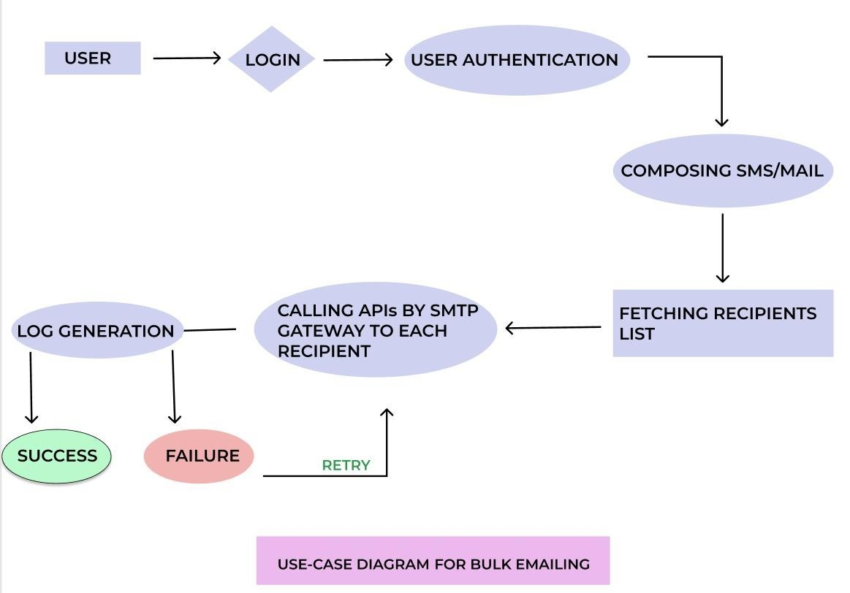
FLOWCHART TO DEPICT BULK SMS/EMAILING

Slide 7
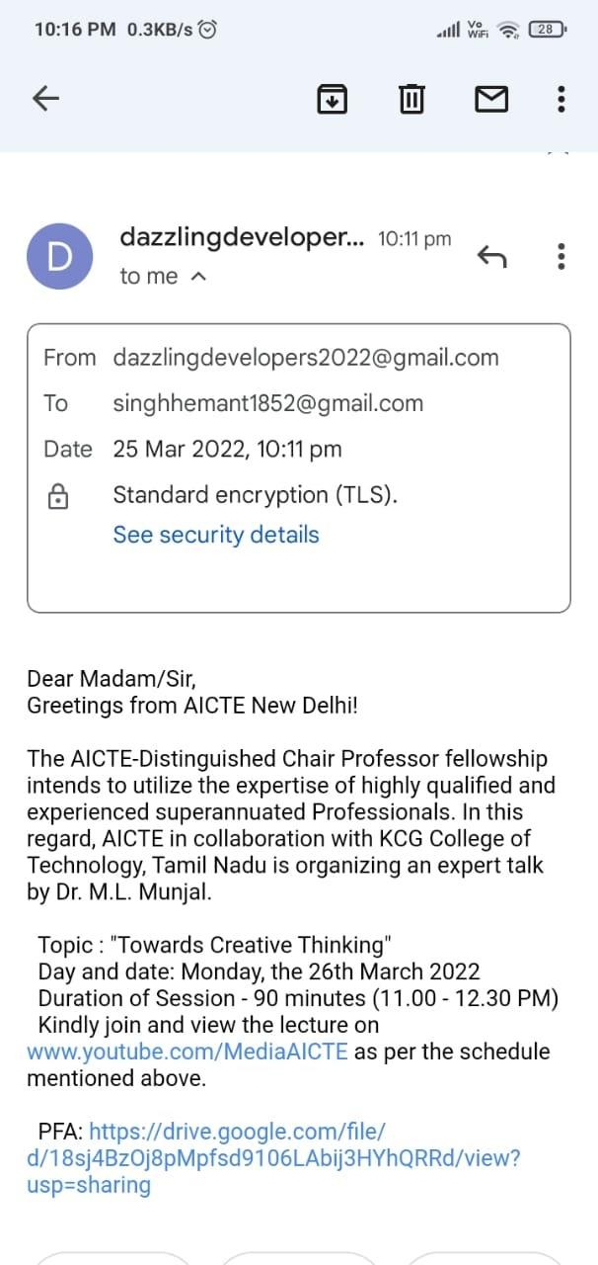






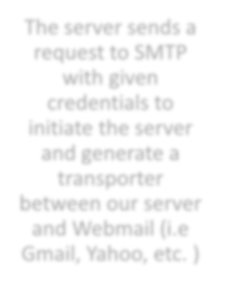




BRIEF WORKFLOW DISPLAY
The server sends a request to SMTP with given credentials to initiate the server and generate a transporter between our server and Webmail (i.e Gmail, Yahoo, etc. )
On Each Call(), the SMTP server reverts back the response each time the mail gets delivered to the recipient with the status code and accordingly log gets generated.
First user authentication is done by getting a valid email id and password.
{
accepted: [‘receivermail@gmail.com’],
rejected: [],
response: '250 2.0.0 OK 1648218439 z16-
20020aa78890000000b004fad8469f88sm6986887pfe.38 - gsmtp’,
messageId: '<2e1b0574-082f-83bf-d028- cb786726fac5@gmail.com>'
}
Generated Log-

Slide 8
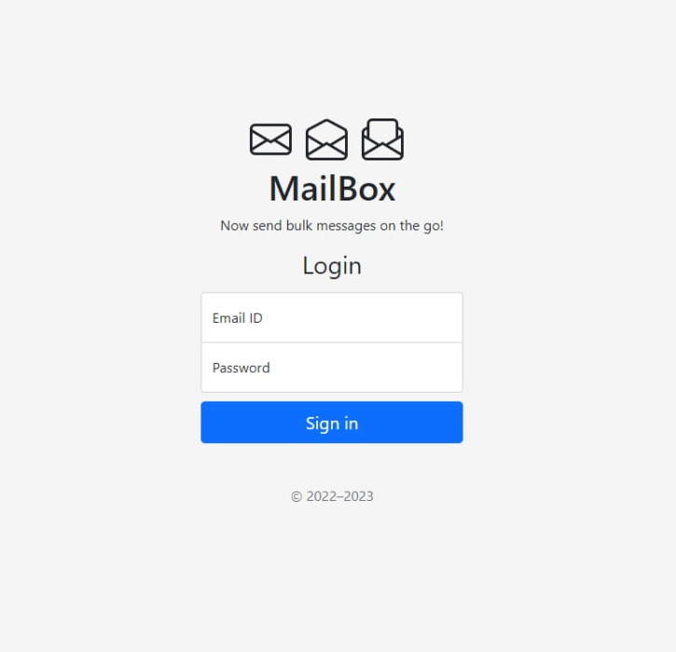
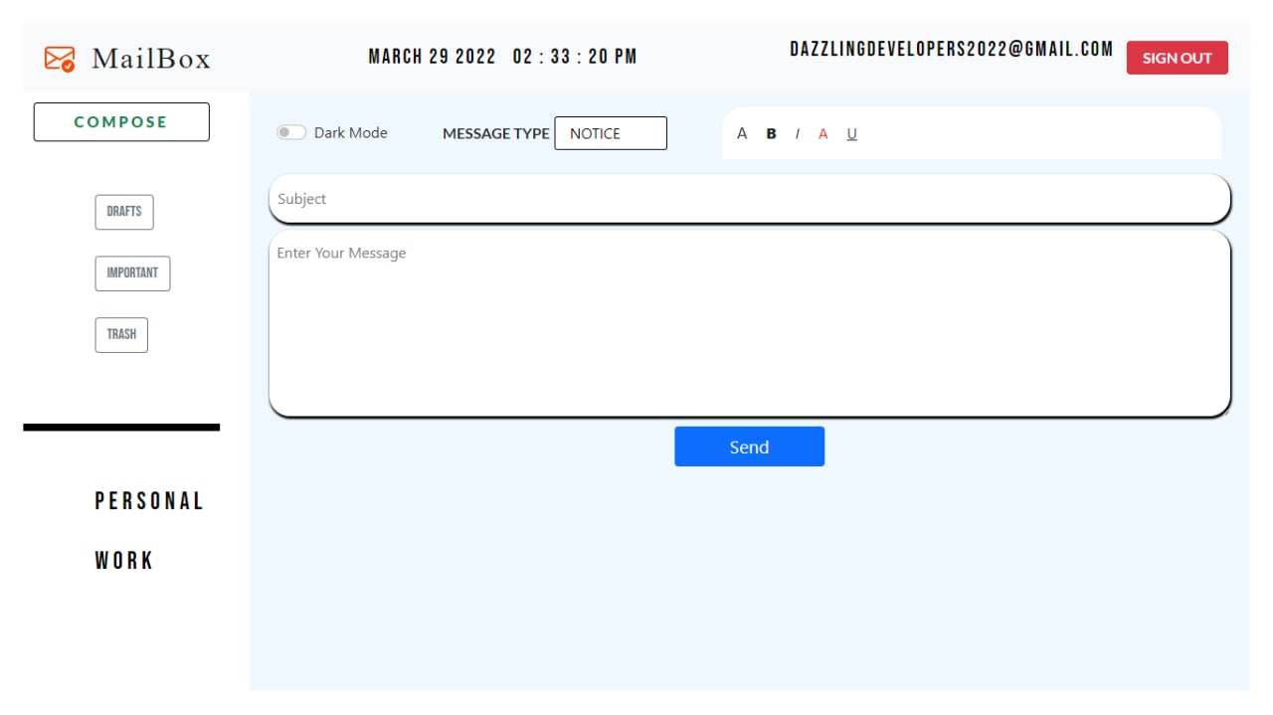
USER INTERFACE OF THE PROTOTYPE
Login & user authentication page
Retrieving and fetching
receiver’s email address
Compose SMS/Email

Slide 9
FEATURES INVOLVED
Reduced processing time with efficient working (cost efficient)
Allows Customization of SMS/emails according to receiver’s details
Categorizes SMS/mail based on their category (such as warning, alert, information)
Importing contact details from excel worksheets
Log generation (success or failure)
Sharing information with a large community
Allows well formatted message sharing
User Authentication
Mail Scheduling

Slide 10
MARKET SCOPE
01
SMS based Pandemic alarming system for the Primary Health centers to manage public health information.
02
Banking and Finance alerting system for server as well as user bank details
03
Subscription reminders to organization’s Newsletters, new products and upcoming release notes
04
Beneficial for the marketing companies/agencies who wants their services to be advertised
05
Travel & Tourism, Restaurants, E- Commerce, recommendations based on preferences on public utilities, Real Estate, Media, Education etc.

